Slide 1


Parent AI App Proposal
Introducing an AI-powered app to support new parents and expectant families with limited support networks.

Slide 2
Breaking Down Barriers: The Parental Journey's Hurdles
Expectant mothers and new parents face numerous physical, emotional, and logistical challenges throughout their parenthood journey.
Many individuals struggle due to insufficient access to vital information and support networks, amplifying their stress and uncertainty.
Parent AI's chatbot delivers tailored assistance to meet the individual needs of users, empowering them to navigate parenthood confidently.
Our bot provides a range of support services including answering queries, offering advice, and supplying educational materials, alleviating the burdens of parenthood.

Slide 3

Target Audience
Expectant Parents: Seeking guidance on prenatal care, fetal development, childbirth preparation, and early parenting.
New Mothers: Needing assistance with recovery, breastfeeding, newborn care, sleep deprivation, and emotional support during the postpartum period.
Parents-to-Be with Limited Support: Feeling isolated and unsure about where to find reliable information and emotional support during pregnancy and early parenthood.

Slide 4


Features And Functionality of Parent AI
Parent Bot
Personalized chatbot to guide expectant and new parents through their journey.
Access trusted resources on pregnancy, childbirth, postpartum care, and parenting.
Get answers to questions and receive tailored support on your unique needs.
Booking Appointments
Seamlessly schedule appointments with healthcare providers and specialists.
Integrate with calendars to view availability and book conveniently.
Customize preferences for appointment types, locations, and healthcare providers.
Receive reminders to ensure you never miss an important prenatal or postpartum visit.

Slide 5
Technology Stack and Frameworks
AI Foundations
Frontend Mastery
Robust Backend
Additional Tools
Leveraging advanced chatbot frameworks like Rasa and DialogFlow
Crafting intuitive user experiences with React.js
Leveraging Node.js and Socket.io for seamless real-time interactions
Implementing JWT for robust authentication and authorization
Combining the power of HTML, CSS, and JavaScript
Harnessing powerful NLP models such as BERT, GPT, and RoBERTa
Utilizing MongoDB and Mongoose.js for secure data management
Integrating WebRTC for high-quality video conferencing capabilities
Building upon the capabilities of PyTorch deep learning framework

Slide 6
Ensuring App Security:
Advanced Security Measures
Compliance with Data
Privacy Regulations
Continuous Monitoring
and Updates
We employ robust encryption and security protocols to safeguard your data from unauthorized access.
Our adherence to GDPR and HIPAA ensures that your personal information is handled with the utmost care and confidentiality.
We regularly assess and update our security measures to address potential vulnerabilities and stay ahead of emerging threats.

Slide 7
Monetization Strategy: Driving Revenue and Ensuring Sustainability
Data Licensing and Insights
Advertising Revenue
Affiliate Partnerships
Integrate targeted ads based on user preferences, partnering with relevant brands for pay-per-click or pay-per-impression models.
Establish partnerships with brands and services catering to expectant parents and new mothers, earning commissions through referrals.
Leverage anonymized user data to provide valuable market research and analytics to healthcare providers, researchers, and industry stakeholders.

Slide 8


Project Implementation Roadmap
Planning
1
Define objectives, gather requirements, create project plan
2
Designing
Design intuitive UI, define architecture, create wireframes
Developing
3
Build frontend, backend, and integrate AI capabilities
Notes:
getting to our implementaion stage the foucs has been how we can make our goals and objectices line up with our path. and we start that with our desiging stage where we looked at how we can design and create a user freiendly enviorement how we can make it accesible to as many people as possible we can reach after figuring out what we want the ui to look like we will move on to the third stage devloping the product using our frontend and backend experities as well as intergarating capebilites to our webapp
Slide 3: Implementing, Testing, Launch
Introduction to the implementation phase: Highlight the transition from planning and designing to the actual development of the application.
Frontend Development: Discuss the development of frontend components using HTML/CSS/JavaScript and frameworks like React.js to bring the UI/UX designs to life.
Backend Development: Explain the process of building the backend logic and functionality using Node.js, Express.js, and MongoDB, integrating with third-party APIs as needed.
Integrate AI Functionality: Describe the integration of AI models for chatbot functionality, including model selection, data preparation, training, and optimization.
Testing: Discuss the importance of rigorous testing, including unit testing, integration testing, and AI model validation, to ensure the reliability and effectiveness of the application.
Launch: Explain the final step of deploying the application to a staging environment for final testing and refinement before the official launch to the public. Mention the marketing and promotion strategies to generate buzz and attract users to the platform.

Slide 9
Project Implementation Roadmap
1
Frontend Development
Bringing designs to life
2
Backend Development
Powering the app's functionality
3
Data Preparation
Curating datasets for training
4
Model Training
Optimizing AI performance
5
Evaluation & Optimization
Enhancing chatbot responsiveness
From crafting intuitive user interfaces to building robust backend systems, our development team will work tirelessly to bring the Parent AI app to life. Alongside this, we'll meticulously prepare diverse datasets, train AI models, and continuously evaluate and optimize the chatbot's performance to ensure seamless and empathetic interactions with users.
Notes:
Introduction to the implementation phase: Highlight the transition from planning and designing to the actual development of the application.
Frontend Development:cfrontend components using HTML/CSS/JavaScript and frameworks like React.js to bring the UI/UX designs to life.
Backend Development: building the backend logic and functionality using Node.js, Express.js, and MongoDB, integrating with third-party APIs as needed.
Integrate AI Functionality:
This involves choosing the appropriate AI model or algorithm to power the chatbot functionality. Different models may excel in different tasks, such as understanding natural language, generating responses, or providing recommendations. Common choices include pre-trained models like those available through libraries like Hugging Face Transformers, or custom models built using frameworks like TensorFlow or PyTorch.
Data Preparation:
Before training the AI model, it's essential to prepare the training data. This involves curating and preprocessing datasets containing examples of conversations, queries, or inputs, along with their corresponding responses or outputs. The data must be cleaned, structured, and annotated as needed to ensure its quality and relevance for training the model effectively.
Training:
Once the data is prepared, it's used to train the AI model. Training involves feeding the model with input-output pairs from the training dataset and adjusting its internal parameters iteratively to minimize errors and improve performance. The goal is to teach the model to accurately predict the correct response or action for a given input based on patterns learned from the training data.
Optimization:
After training, the model may undergo optimization to further improve its performance. This may involve fine-tuning the model's hyperparameters, adjusting its architecture or structure, or applying optimization techniques to enhance its accuracy, efficiency, or robustness. The optimization process aims to maximize the model's effectiveness in providing accurate and relevant responses to user queries or inputs.
.
Testing: Discuss the importance of rigorous testing, including unit testing, integration testing, and AI model validation, to ensure the reliability and effectiveness of the application.
Launch: Explain the final step of deploying the application to a staging environment for final testing and refinement before the official launch to the public. Mention the marketing and promotion strategies to generate buzz and attract users to the platform.

Slide 10



Project Implementation Roadmap
AI Model Validation
User Simulation Testing
Curating Training Data
Evaluate model performance and robustness.
Identify and address model limitations.
Ensure ethical handling of user data.
Deploy to a staging environment for final refinement.
Implement a strategic marketing plan to attract users.
Launch the application and monitor performance.
Notes:
Testing: Discuss the importance of rigorous testing, including unit testing, integration testing, and AI model validation, to ensure the reliability and effectiveness of the application.
Launch: Explain the final step of deploying the application to a staging environment for final testing and refinement before the official launch to the public. Mention the marketing and promotion strategies to generate buzz and attract users to the platform.

Slide 11
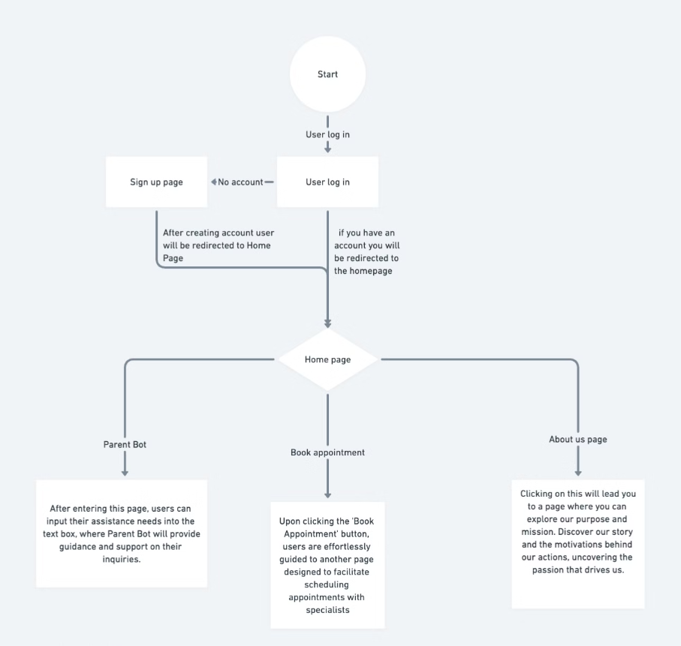
User Flow Diagram Chart
Notes:
here we have a flow diargam chart of how our web app will work and where you will be redirectied and what happens depending on what you click this user flow diagram chart allows users a visual tool to see how our web app works hopfully making it easier to use

Slide 12
Link To Our Website
https://azmeenkaausar.wixsite.com/parentai-2

Slide 13
Our team
We think innovation should be merged compassion in the realm of parenthood. We are a dedicated team committed to revolutionizing the journey of pregnancy and postpartum care through our groundbreaking web application. With our Web app we recognize the profound impact that technology can have on easing the challenges and uncertainties faced by expectant and new parents. Our vision is simple yet transformative: to provide a comprehensive support system that accompanies users every step of the way, from conception to early parenthood.we are dedicated to crafting a solution that not only meets but exceeds their needs and expectations. Together, we are redefining the boundaries of parenthood support, one innovative feature at a time.
— Azmeen Kausar, Sanya Sahni, Manish Sharma

Slide 14
Thank You

